Slide 1
Physical Fitness for youth & Adults
Eoin Bradley

Slide 2
What is Physical Fitness ?
Aerobic Endurance
Skills
Strength
Player
Speed/ Power
Flexibility/ Mobility
Agility

Slide 3
What most important
Mobility Flexibility
Strength / Movement
Aerobic Endurance
Power
Speed
Agility
Skills

Slide 4
Know Your Sport
GAA Football needs
10 to 7.5 Km per game = 70% of this is walking and jogging
2-4mins of total match is spent sprinting over 19kph- average distance 3m to 20m
60- 80 COD
Jumping, Tackling and Lots of Impacts

Slide 5
Season
Nov | Dec | Jan | Feb | Mar | Apr | May | Jun | Jul | Aug | Sept
S&C | S&C | S&C | End | End | Lea | Lea | Lea | Lea | Cha | Cha
 |  | End | Speed/ Power | Speed/ Power | Skills/ Tactic | Skills/ Tact | Skills/Tact | Skills/Tact | Skills/Tact | Skills/Tact
 |  |  | Skills/ Tactics | Skills/ Tactics | End | End | End | End | End | End
 |  |  |  |  | S&C | S&C | S&C | S&C | S&C | S&C

Slide 6
Mobility Circuits/ Recovery
BW Squats/ Goblet
Lunge walk
Mini band walk
Single leg RDL
OH Band stretch
Press up
Sit up
Russian Twist
Spiderman crawl
Lateral lunge – Resisted

Slide 7
Beast Circuit
Load Barbell to 40% of 1rep max
Deadlift
Clean from hang
Front squat
OH Press
Bent over row
3min Run at 80% MHR

Slide 8
Endurance session
10 x 100m sprint - target time = 14sec
Work to Rest 1:3 = 42sec
10 x 60m Sprint – Target time = 9sec
Work to Rest 1:3 = 27sec
10 x 20m Sprints – 1:2 or 1:1
3 x 90m in 60sec – 60sec Rest
4x 80m in 60sec – 60sec Rest

Slide 9
20m by 10m Pitch
5 vs 5 2min match
30sec to move over to ladders
60sec through ladders
30sec to get back into team
Repeat 5

Slide 10
Development
U-14 main aims
Basic Movement equality
FMS exercises stretching
Stability exercises for core
Disruption of body weight
U-15 main aims
Stability exercises for ankle, knee and core
Teach Proper Landing
Marching leading to sprint technique
Corrective and strengthen exercise

Slide 11
U-16 squad main aims
Strengthen movements
Teaching proper weight lifting techniques (load light)
Jumping and landing phase (Plyometric)
Sprinting and cutting techniques
Corrective exercise
U-17 squad main aims
Increase strength and power
Start to increase loads while maintaining proper technique
Increase loading in plyometric phase
Teach bases for Olympic lifting

Slide 12
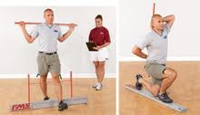
Testing Tools
Functional movement screen (FMS) – 7 Exercises
OH Squat
Hurdle step
Inline lunge
Shoulder mobility
Hamstring raise
Truck stability push up
Core stability

Slide 13
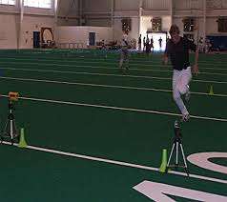
Strength Testing – 1RM- 3RM
Power Testing – vert jump right & left
Muscle endurance – inverted row, push up
Fitness – yoyo test, 2.4km, beep test, Cooper test
Body Fat – learn muscle – 7site skinfold
Speed Test – AFL agility, T-Test, straight line 5m,10m 20m, 30m, 40m – max speed and accl

Slide 14
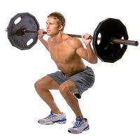
Big Bang Exercises
Squats
Back Squat, Front Squat, Over head squat
Quadriceps
Hamstrings
Calves
studies have linked squatting strength with athletic ability Specifically, squatting helped athletes run faster and jump higher, which is why this exercise is part of virtually every professional athlete's training program.

Slide 15
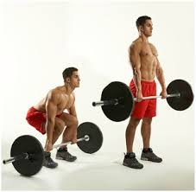
Deadlift
Muscles Used
Core (abs and obliques)
Hamstring
Glutes
Forearms
Spinal Erectors
Lower Back,
Middle and Upper Traps
Calves
“Everyone should perform some form of the deadlift because it strengthens the whole body, protects you from pain and injury, and teaches you to move properly”
(Charles Poliquin)

Slide 16
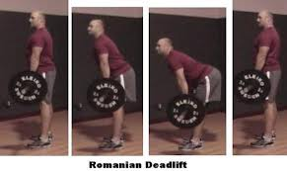
Romanian Deadlift (RDL)
Muscles Used
Lumbar Erectors
Gluteals
Hamstrings — primarily the hamstrings.
Benefits
Enhances speed development helps to prevent
Injury.

Slide 17
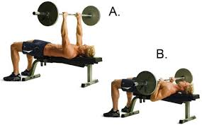
Bench Press
Muscles Used
Shoulders
Pectorals
Forearms
Triceps
BENEFITS
Bench press is a compound workout, almost all muscles of your upper body are involved this helps when time is a issue in the gym.
It also promotes bone density and stimulates the nervous system

Slide 18
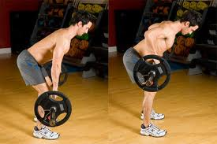
Bent Over Row
Muscles
Lats
Rhomboids
Rear Delts
Traps
Biceps
Benefits
This exercise works large and specific muscles (full back) yet engage the whole system fingers to toes. The bent torso acts as a lever under the resistance of the bar. The lower back (the spinal vertebrae supported by the erectors) provides the fulcrum and bears an extraordinary load.

Slide 19
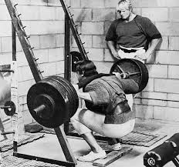
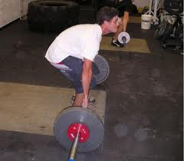
Rules
Technique most important (not about how much you lift its how you lift it)
Front –Back, Push – Pull
Working Full length of muscles
Breathing

Slide 20
Programme design
Template
Muscle activation, movement pre – (warm up)
(10min)
Power/ Plyometrics
(10min)
Skills
(5min)
Strength
(30min)
EDS – (Endurance)
(10min)
Recovery (cool-down)
(10min)

Slide 21
Planning & programming
Strength
Working at 70% - 90% of 1RM
From about 3-6 reps
Around 3-5 sets
This allows the lifter to handle near maximal loads without pushing to the point of a true one repetition maximum
Rest (3 – 5min)
Power
Working around 40% -60% of 1RM
From between 2-5 reps,
Between 5-10 sets
Using fewer reps (2-5) allows you to facilitates proper technique on all repetitions and delays the onset of fatigue
Rest (1:8)

Slide 22
Hypertrophy
Working between 60% - 80% 1RM
Between 4-5 sets and 8-10 reps
Working at a moderate range of 4 sets of 10 reps allows the lifter to handle loads that stress the muscle quickly while facilitating sufficient time under tension.
Rest (3-5min)
Muscular Endurance
Working between 20% - 60% 1RM
Between 3-4 sets and 12 – 20 reps
A set and rep scheme of 3 sets of 20 reps allows the lifter to work for extended periods of time, thereby improving muscular endurance.
Rest time (30s – 60s)

Slide 23
Variety
Change Training
No 2 sessions the same
Lots of different drills
Try to use a ball during endurance sessions
Get feedback from the players

